Slide 1
Cross Domain Communication Using XMPP Protocol

Slide 2
Introduction
In the twenty-first century, instant messaging has assumed a monumental role and the number of service providers providing this feature has burgeoned.
Every user connected to the World Wide Web may not have an account on every service provider. The need for people from different locations and fields of expertise to communicate has increased.
Thus, there arises a need to have one platform where users having accounts on different domains can communicate, exchange information and collaborate on different projects.

Slide 3
Introduction
The project entitled - CROSS-DOMAIN COMMUNICATION USING XMPP PROTOCOL aims at providing one common platform for communication. Instead of logging in to different accounts for communicating with different people, we can achieve all at one place.
This project could be extended to allow users to create a group where in members can be using different servers and enables group communication between them.

Slide 4
Aims and Objectives
A chat client for local server has been developed which provides facility of chatting between users logged in to various domains (or service providers).
The project aims to make this application ubiquitous, thereby allowing access from the web and removing the need of a desktop application.
The project also aims to develop an application that would achieve this cross-domain communication at the audio level which would be an extension to the text solution.

Slide 5
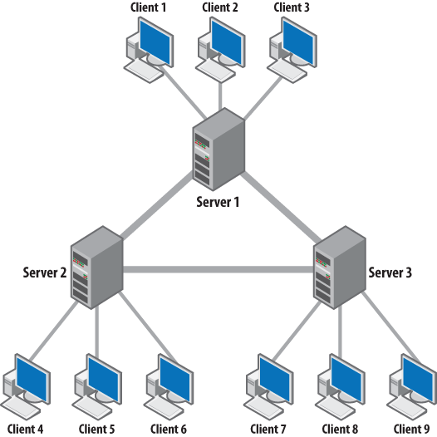
XMPP
eXtensible Messaging and Presence Protocol
It is an open source standard which is decentralized and interoperable.
XMPP was initially known as Jabber.
It uses XML.

Slide 6
Why XMPP?

Slide 7
Where can this be used?
The concept of a chat client can be extended and applied to users logged on to different social networking sites or applications that have their own chat clients.
For example, Flipkart has introduced Ping that lets customers share product images and discuss with each other while shopping on the e-commerce platform.
Thus, using this application a person using Flipkart Ping can communicate with a user logged on to Google Hangouts.

Slide 8
Overview of our Project
Cross-Domain Communication
Desktop Application
Text
Audio
Text
Project
Application Type
Elements Supported
Web Application

Slide 9
Desktop Application for Text

Slide 10
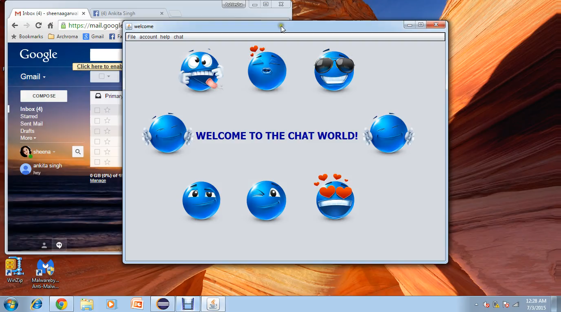

Slide 11
Web Interface

Slide 12
When a user interacts with other users and applications on the network (through a computer), there are two basic types of interaction:
Client Initiated: Here the user makes a decision to do something. The client (the software on the computer that the user is using) will send protocol to a server on the network. Typically this forms a request/response pattern, with the client making a request and the server providing a response, although XMPP allows for other patterns.
Server Initiated: Here the user is passive. Something happens remotely; A server sends something to a client; The user is alerted or informed in some way. This may form either a request/response pattern or a pure server-push where no response is expected.

Slide 13
Stroph.js
Strophe.js is an XMPP library for JavaScript. Its primary purpose is to enable web-based, real-time XMPP applications that run in any browser.
Since JavaScript had no facilities for persistent TCP connections, this library uses Bidirectional-streams Over Synchronous HTTP (BOSH) to emulate a persistent, stateful, two-way connection to an XMPP server.

Slide 14
strophe.js API
$build, $msg, $iq, $pres
addHandler()
connect()
getBareJidFromJid()
getText()
disconnect()
log()
send()

Slide 15
BOSH
BOSH is a means of carrying the XMPP protocol over HTTP. BOSH defines a simple framing to use these packets in HTTP protocol.
For client initiated protocol the client simply sends packets over HTTP (using HTTP post).
Server initiated protocol is handled by a technique called 'long polling'. In long polling, the web browser initiates a standard request, but does not expect a response back immediately. When the server has data to send, it will send it as a response to the request, and the client will immediately issue another request, thus keeping a request pending for the server to respond to.

Slide 16
Problems with Strophe.js
Connection with Facebook
Connection with Gmail
Connection with OpenFire Server

Slide 17
Connection with FACEBOOK

Slide 18
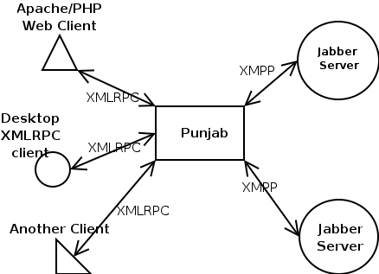
1. Configuring Punjab Server as BOSH Connection Manager:
Punjab is sort of a blackbox. It has a xmlrpc api that client's make method calls to and it then converts them into jabber messages and returns them based on the methods the client's call. What goes on in between does not really matter to the client developer.

Slide 19
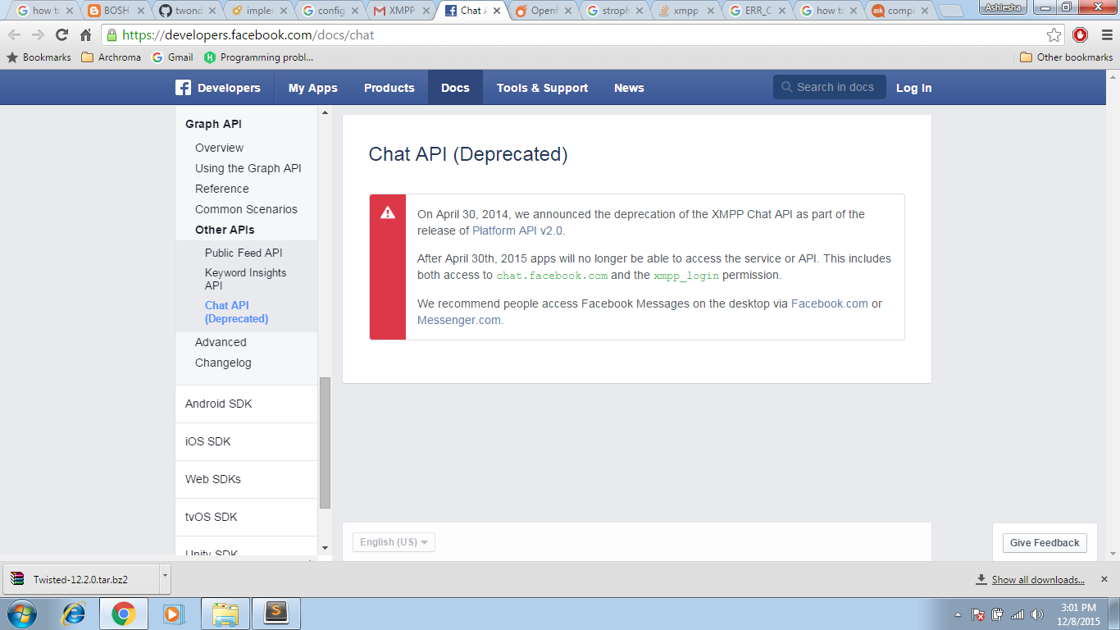
2. Connecting with Strophe.js
The connection could not be established even after repeated trials to connect Facebook XMPP Server using strophe.js and the configured Punjab BOSH Connection Manager. The reason behind it is the deprecation of the Facebook Chat API which does not allows to connect to the Facebook XMPP Servers.

Slide 20
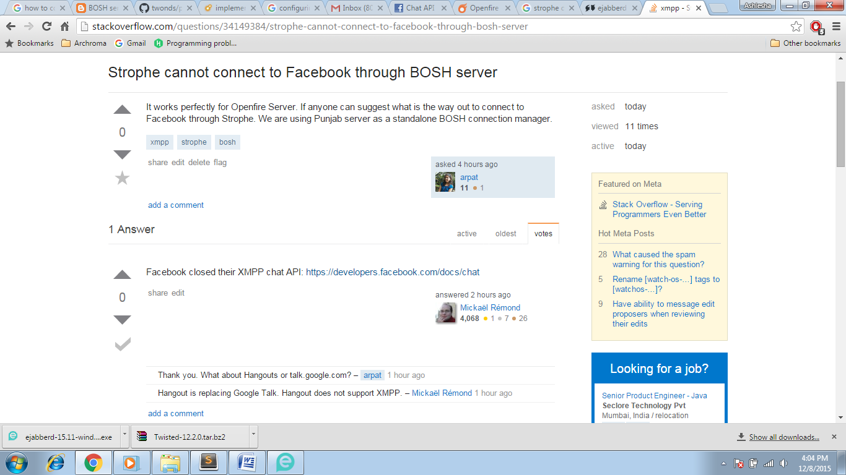

Slide 21
B. Connection with GMAIL

Slide 22
1. Configuring Punjab Server as BOSH Connection Manager
Same procedure as in ‘Connection with Facebook’
2. Connecting with Strophe.js
Since Google has stopped GTalk and switched over to Hangouts, the XMPP connection to Google Server is denied using Strophe.js library as XMPP no longer is the underlying protocol.

Slide 23
Next : Trying with JSP

Slide 24
Using CometD
CometD is a set of libraries to write web applications that perform messaging over the web. Whenever you need to write applications where clients need to react to server-side events, then CometD is a very good choice.
CometD ships a JavaScript client library, a Java client library and a Java server library. The server library, being in Java, leverages the high scalability of the JVM and the powerful asynchronous I/O API that the JVM and the Servlet specification provide.
CometD is transport agnostic: you write your applications using high level APIs, and CometD takes care of delivering the messages over the wire using the best transport available: WebSocket or HTTP.

Slide 25
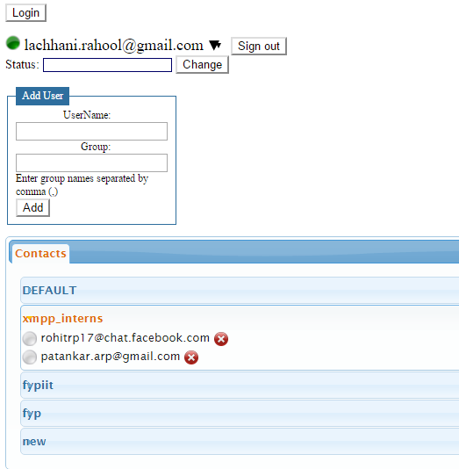
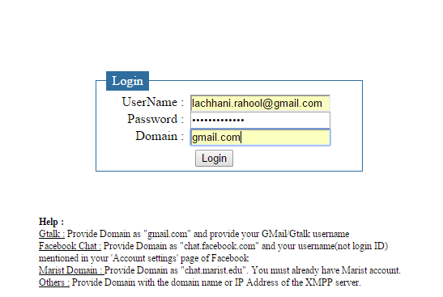

Slide 26
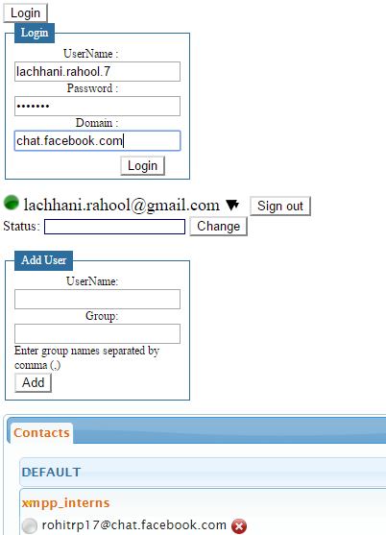
Problems faced with CometD and JSP
It works properly for a single domain. However, when we try to connect to two different domains (service providers) using a single client, the connections interfere with each other. This is because CometD library cannot handle multiple connections at the same time.

Slide 27
C. Connection with Openfire Server

Slide 28
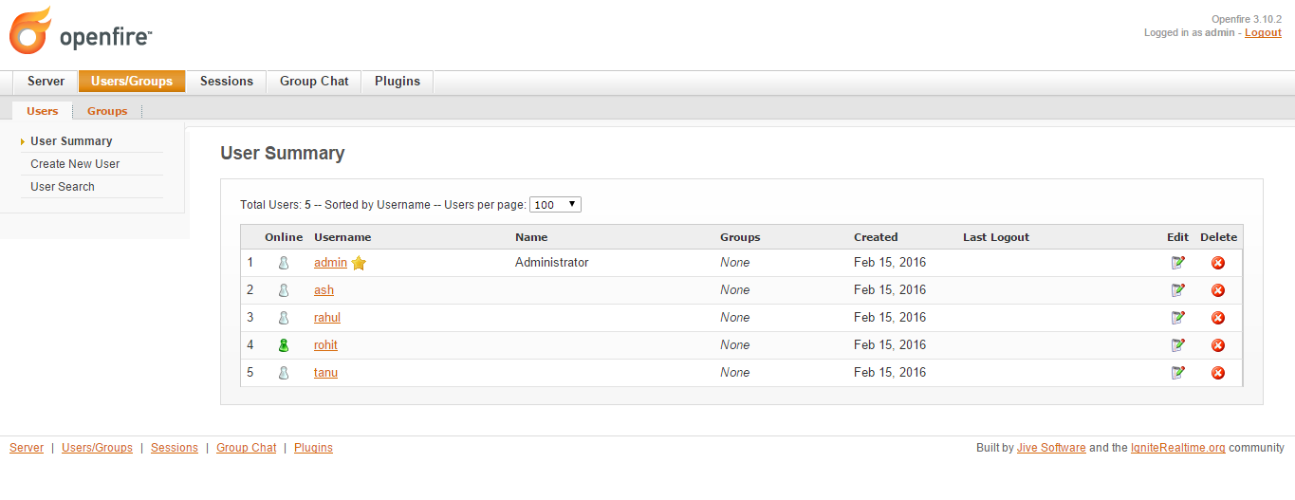
Installing, Configuring and Testing Openfire Server on local machine:

Slide 29
2. Configuring BOSH
BOSH (Bidirectional streams Over Synchronous HTTP) specified in XEP-0124 is the standardized way to do XMPP over HTTP. BOSH is simply a means of carrying the XMPP protocol over HTTP. The XML XMPP packets used in BOSH are the same as the ones used when standard XMPP is run over TCP. BOSH defines a simple framing to use these packets in HTTP protocol. For client initiated protocol the client simply sends packets over HTTP (using HTTP post). Server initiated protocol is handled by a technique called 'long polling'. In long polling, the web browser initiates a standard request, but does not expect a response back immediately. When the server has data to send, it will send it as a response to the request, and the client will immediately issue another request, thus keeping a request pending for the server to respond to.

Slide 30
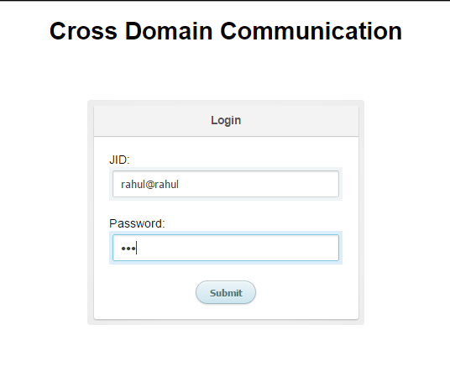
3. Connection with Strophe.js
The connection was established successfully with the Openfire Server
using strophe.js

Slide 31
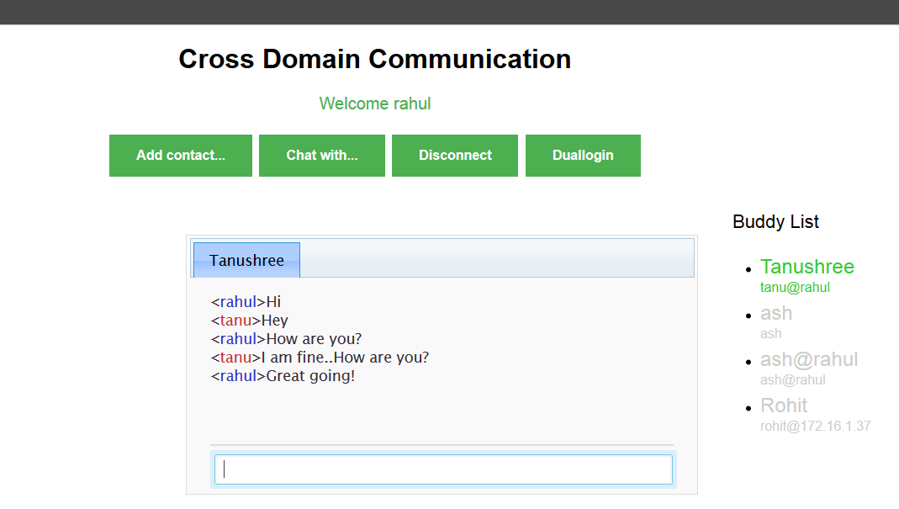

Slide 32
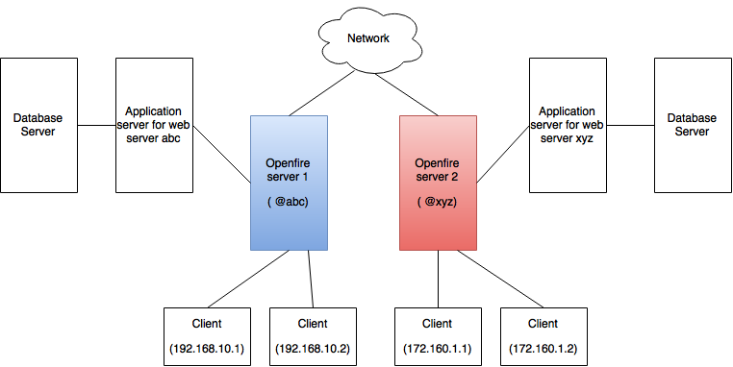
Cross Domain Communication using OpenFire
Architectural Diagram

Slide 33
How This Works ?

Slide 34
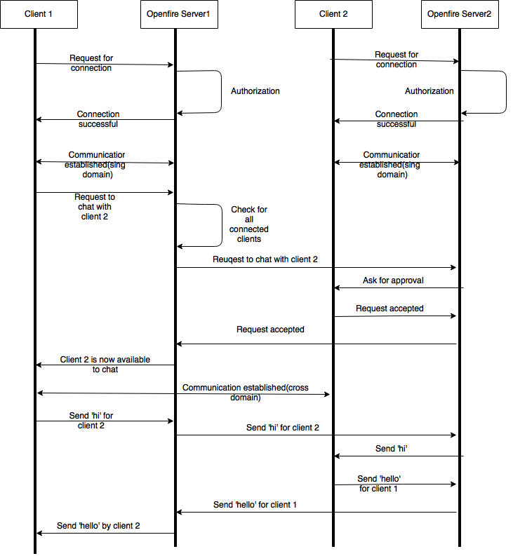

Slide 35
How is this Implemented ?

Slide 36
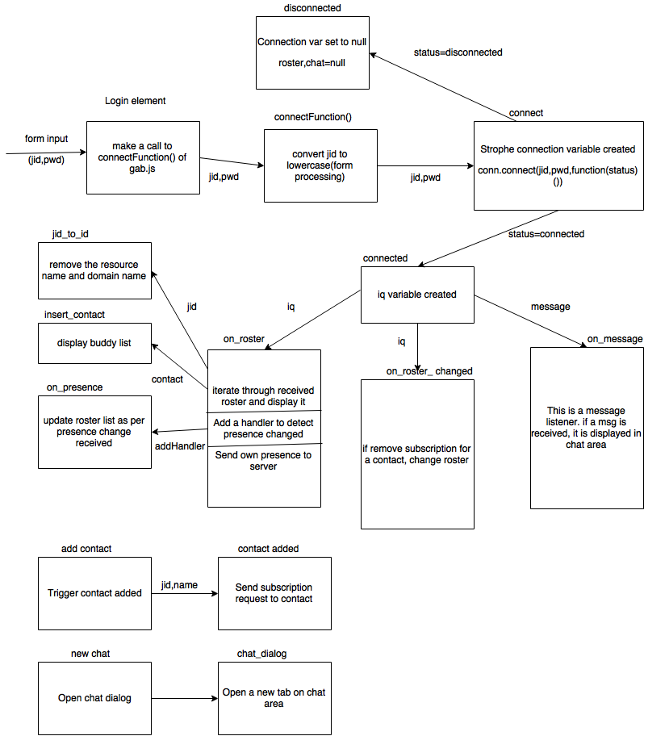
Component diagram for Web Application

Slide 37
AUDIO COMMUNICATION

Slide 38
Session Initiation Protocol
SIP can be used for two-party (unicast) or multiparty (multicast) sessions.
Each resource of a SIP network, such as a user agent or a voicemail box, is identified by a uniform resource identifier (URI). The URI scheme used for SIP is sip: and a typical SIP URI is of the form : sip:username:password@host:port.
SIP is primarily used in setting up and tearing down voice or video calls. It also allows changing addresses or ports, inviting more participants, and adding or deleting media streams.

Slide 39
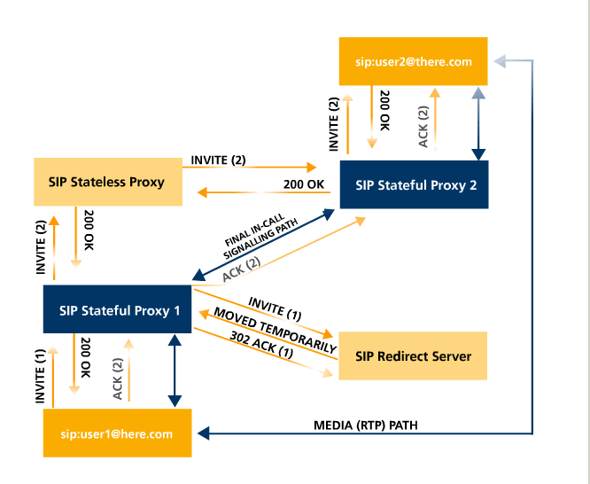
SIP Messages
There are two different types of SIP messages:
SIP request
SIP response

Slide 40
XMPP client
Twinkle
Zoiper
Ekiga
SIP client
Twinkle
Zoiper
Ekiga
XMPP Server
OpenFire
SIP Server
Asterisk
FreeSwitch

Slide 41
XMPP Integration with SIP Server (Asterisk)

Slide 42
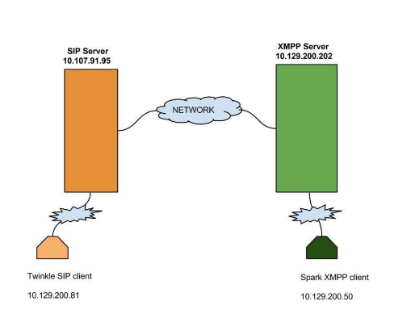
Architecture

Slide 43
XMPP stands for eXtensible Messaging and Presence Protocol. It is a widely used communication protocol.
Asterisk is open source telephony switching exchange service for linux.
We have used Openfire – an open source XMPP Server and FreePBX install on CentOS 6.5.

Slide 44
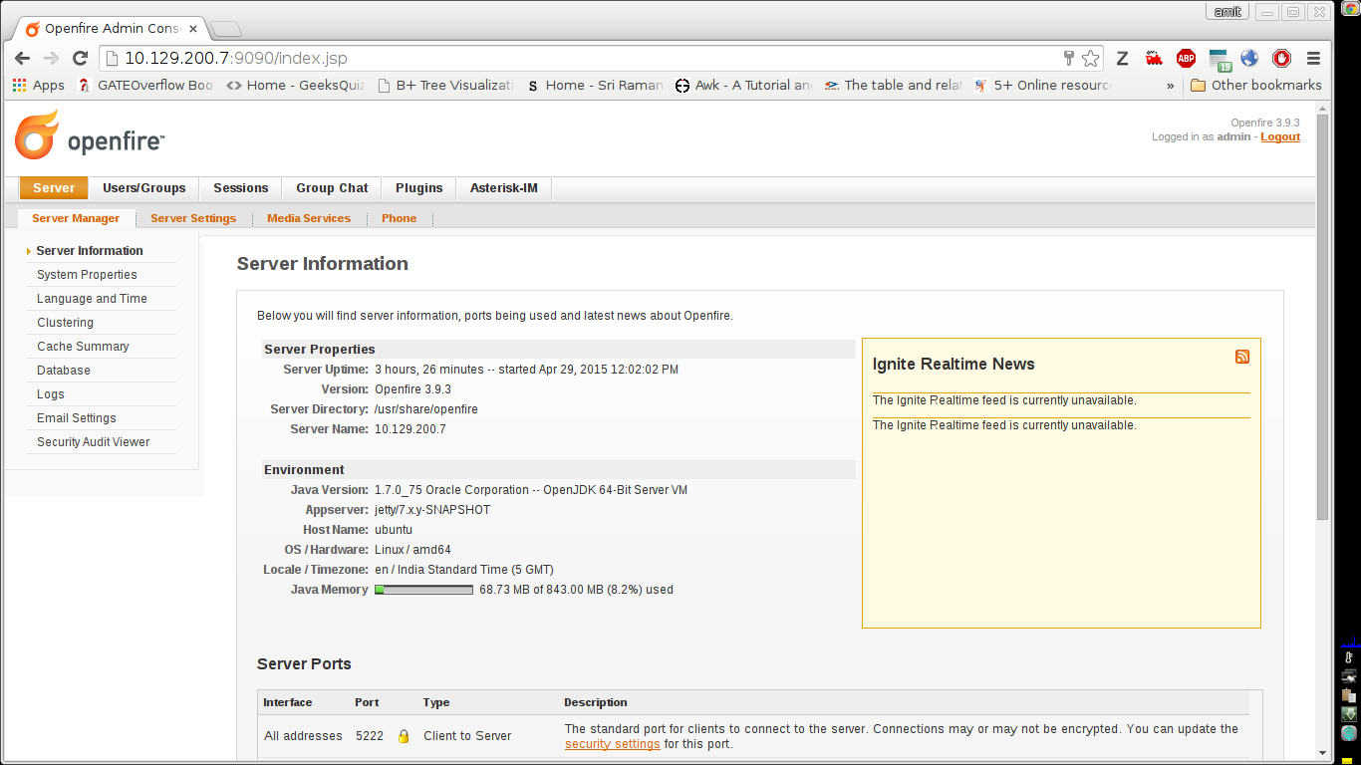
Step 1: Creating a user in xmpp server
Login to openfire server. You will find the welcome screen as in image below and then click on user/session tab.

Slide 45
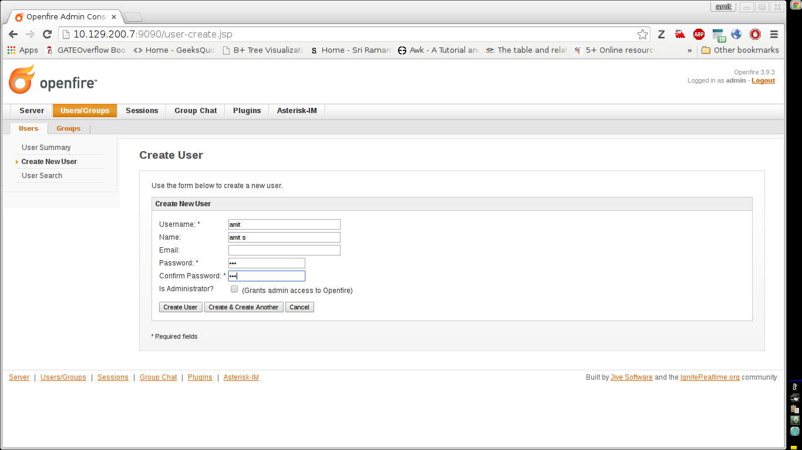
Now provide the user information and click on create user as in image below.

Slide 46
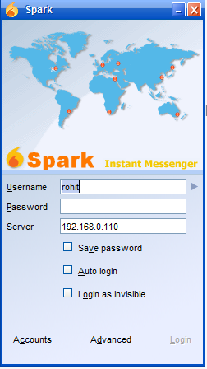
Step 2: Starting Spark xmpp client
You will find the spark client starts as in image below. Provide user id, password which you created in Openfire server and give server ip.

Slide 47
Step 3:Enable SIP plugin to Openfire Step 4: Configure SIP user on asterisk
Now we need to configure sip.conf and extension.conf file to switch the call between asterisk and xmpp client.

Slide 48
sip.conf configuration extension.conf configuration
[100] exten => 100,1,Dial(SIP/100,20) username=100 type=friend secret=123 record_out=never record_in=never qualify=no port=5060 nat=never host=dynamic dtmfmode=rfc2833 call-limit=4 canreinivite=no disallow=all allow=all
The above settings allow sip client to established call to xmpp client which is spark.

Slide 49
Step 5: Configure SIP phone on Openfire
On your Openfire interface go to Phone tab and then click on add new phone mapping and provide the details.
SIP Phone Settings
XMPP username => user name of your openfire user. SIP username => user name on your asterisk server which we configure in sip.conf Authorization username => same as SIP username PASSWORD => password of your SIP user. SERVER => IP of asterisk server

Slide 50
Step 6: Make a call from SIP phone
Now from the SIP phone the extension number 100 is dialled which is of the XMPP client. Once the call is accepted it will get connected.
Thus, we have successfully integrated XMPP (Openfire) with SIP (Asterisk).

Slide 51
Audio Communication using JINGLE Protocol

Slide 52
VoIP support for XMPP : Jingle Protocol
Jingle is an extension to the Extensible Messaging and Presence Protocol (XMPP) which adds peer-to-peer (P2P) session control (signalling) for multimedia interactions such as VoIP ( Voice over IP) or videoconferencing communications.
Jingle provides a way for Jabber clients to set up, manage, and tear down multimedia sessions.
A Jingle negotiation usually results in use of the Real-time Transport Protocol (RTP) as the media transport and thus is compatible with existing multimedia technologies such as the Session Initiation Protocol (SIP).

Slide 53
User A User B
| |
| session-initiate |
|---------------------------->|
| ack |
|<----------------------------|
| session-accept |
|<----------------------------|
| ack |
|---------------------------->|
| MEDIA SESSION |
|<=================>|
| session-terminate |
|<----------------------------|
| ack |
|---------------------------->|
EXAMPLE OF A SESSION-INITIATE STANZA SENT BY THE INITIATOR:
<iq from='usera@xyz.lit/res1'
id='zid615d9'
to='userb@pqr.lit/res2'
type='set'>
<jingle xmlns='urn:xmpp:jingle:1'
action='session-initiate'
initiator='usera@xyz.lit/res1'
sid='a73sjjvkla37jfea'>
<content creator='initiator' name='this-is-a-stub'>
<description xmlns='urn:xmpp:jingle:apps:stub:0'/>
<transport xmlns='urn:xmpp:jingle:transports:stub:0'/>
</content>
</jingle>
</iq>

Slide 54
Jingle for Voice
Jingle can be used to initiate and negotiate a variety of peer-to-peer session. One of the media is voice or video which are exchanged over the Realtime Transport Protocol.
Informational Messages:
Active
Hold
Mute
Ringing

